Slide 1






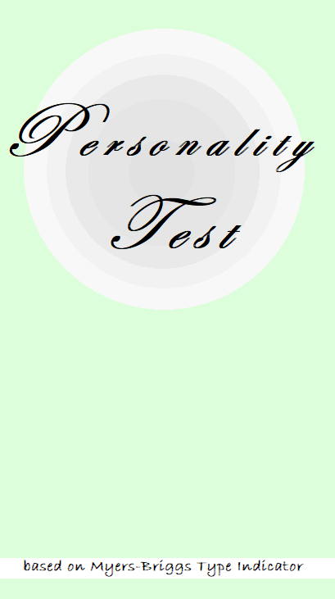

Codechanakya : Hackathon
Personality Detector
Prepared By : Priyam Saha
By Team : Three-rrific-Coders
College : UCER,Prayagraj ; Course :B. Tech. ; Branch : Computer Science ; Year : 3rd

Slide 2
Key takeaways:
Presentation Outline
Project Objective
Technology Platform Overview
Application Snapshot
Team Description
Source credit
Personality Test –By Three-rrific-Coders

Slide 3
This theme requires participants to build an application that predicts the personality type of the user based on the questions answered by the user. The result is based on the personality types described by Myers-Briggs Type Indicator.
Project
Objective
Personality Test –By Three-rrific-Coders

Slide 4
Application Description
“ The results...don't demonstrate that personality is destiny, but they do show that certain personality types are linked to more financially successful and personally rewarding experiences in the workplace ”
This app is made for personality testing, the result depicted is given by Myers & Briggs.
This is for general purpose users(Any one who can operate android smart phone can use this application)
Find github link for this app :
https://github.com/piyushagr00786/Personality-Test/tree/master
Personality Test –By Three-rrific-Coders

Slide 5
Application Description
Option 1: Start test, after the user clicks start test button, a set of 61 questions are asked which the user has to answer according to their choice i.e Agree/disagree
In the backend, RNN model is used for prediction of personality type
We have used Chaquopy to integrate Python and Android
After the test is completed Result button gets activated after clicking which result will be displayed
This activity has a button which redirects user to option 2, ie About 16 personalities
Option 2: About 16 personalities ; This contains a menu of all 16 personality types, the user can navigate and read about their own as well as other personality type
The first activity is a Splash screen, this is made using the concept of thread.
Next is Login page, 1st the user has to Sign Up (once), and then they can sign in using the same credentials
In the backend of this activity we have applied concept of database, here SQLite database is used for storing user data locally.
After successful login user is directed to the home page .User can select one of the two options
Personality Test –By Three-rrific-Coders

Slide 6

Technology Platform Overview
Android
SQLite Database
AI
Android Studio is used as a major software to build this application
SQLite database is used to store user-login credentials locally.
RNN model is used for prediction of User personality
Personality Test –By Three-rrific-Coders

Slide 7
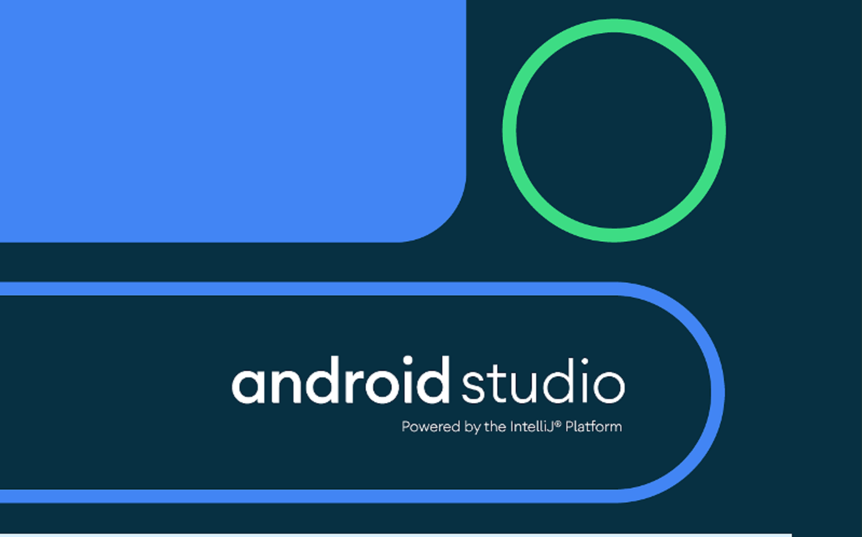
Android Studio
Android Studio is the official Integrated Development Environment (IDE) for Android app development, based on IntelliJ IDEA
We made all the Activities and Layouts in Android Studio (Using Java and XML) and later we linked Python Code (using Chauqopy).
Personality Test –By Three-rrific-Coders

Slide 8
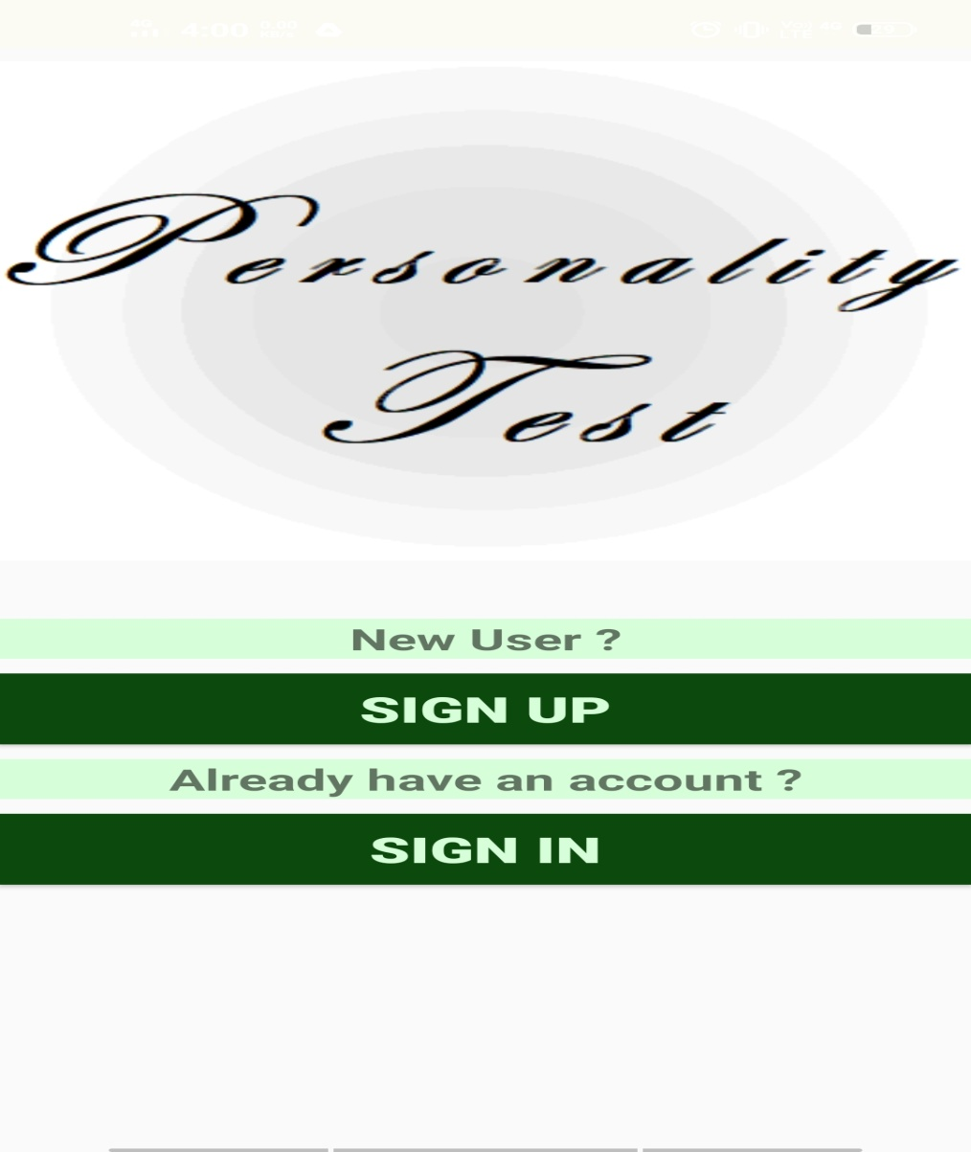
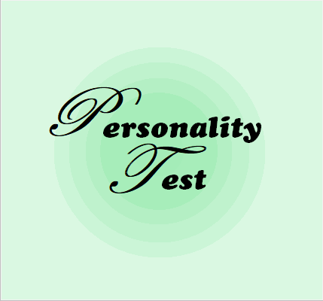
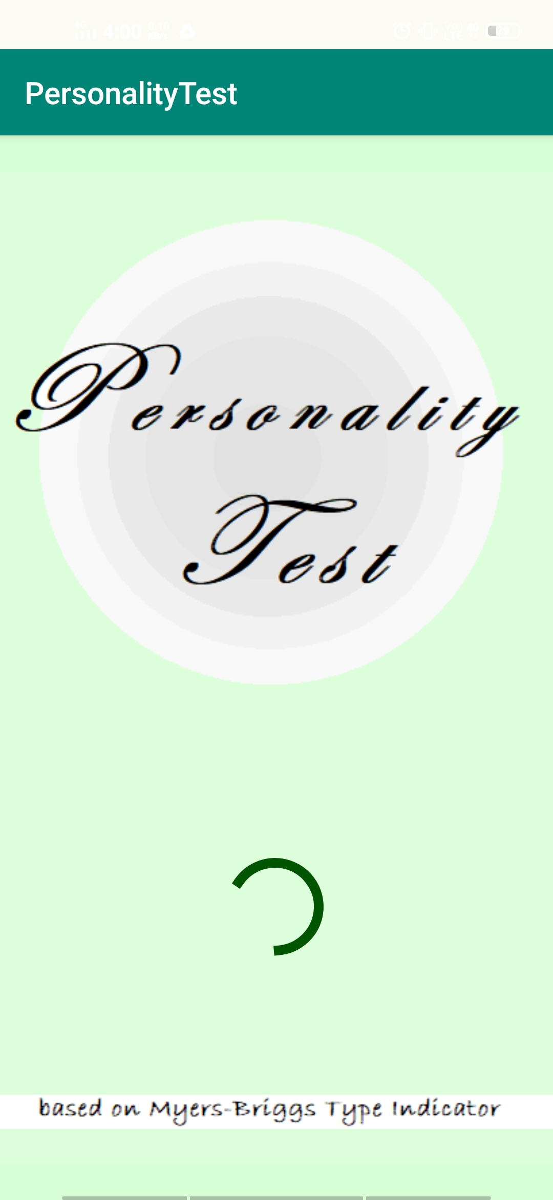
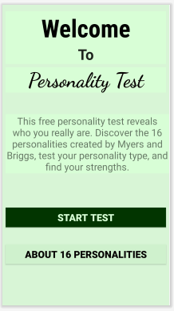
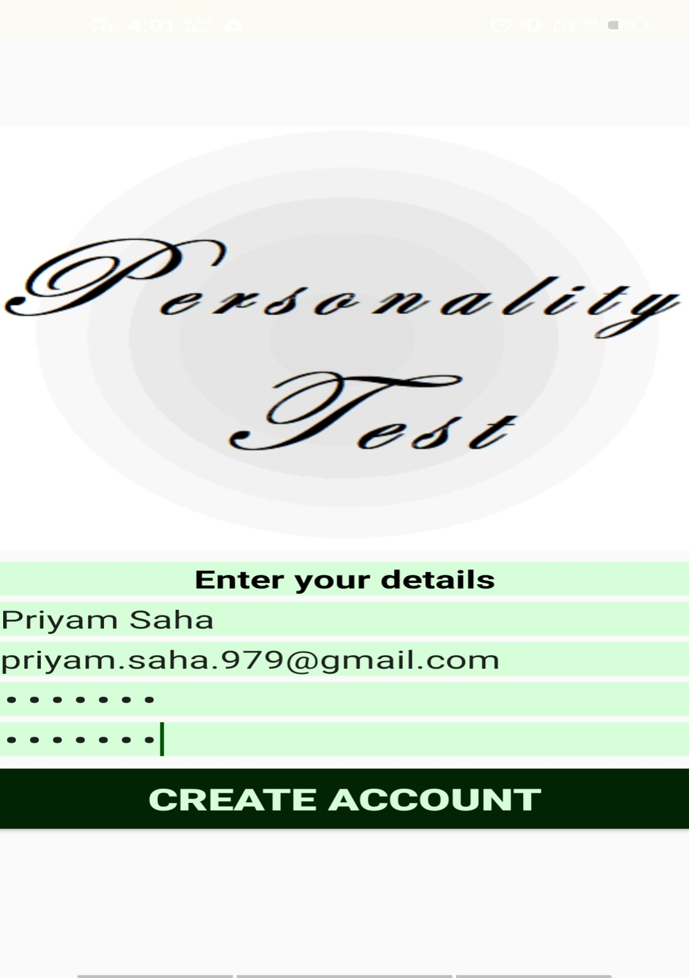
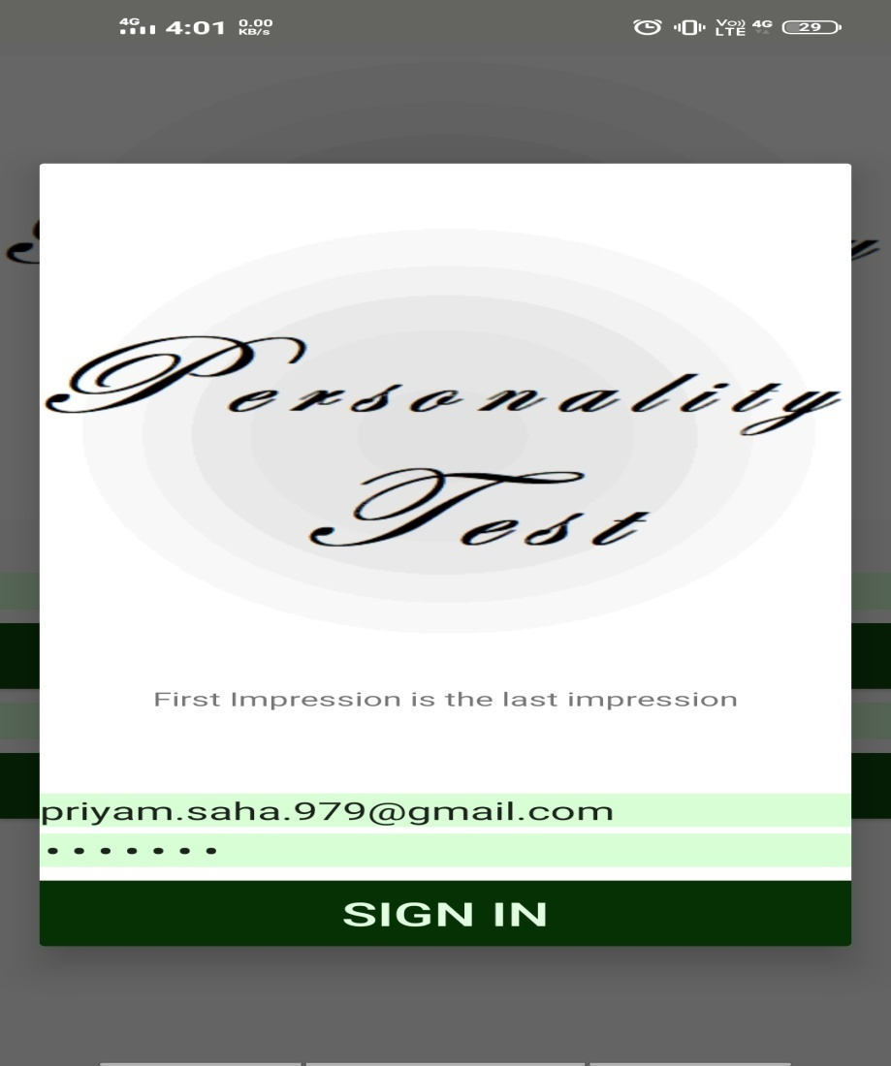
Application Snapshots
Application at a glance
Personality Test –By Three-rrific-Coders

Slide 9
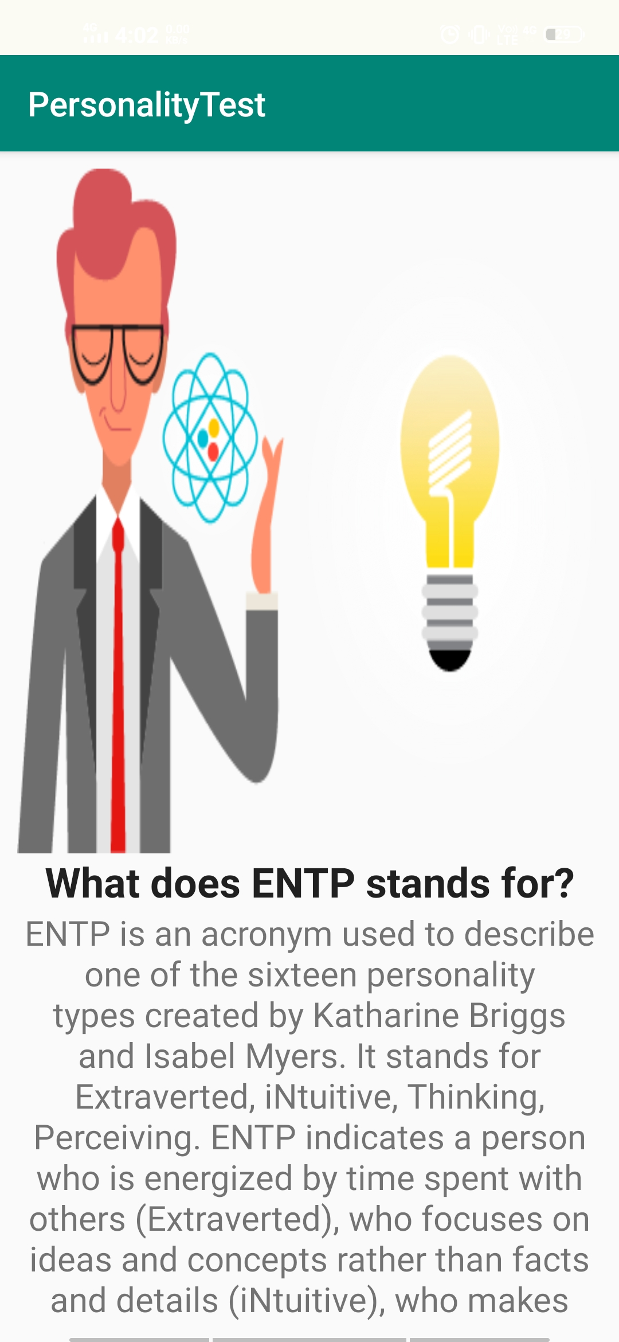
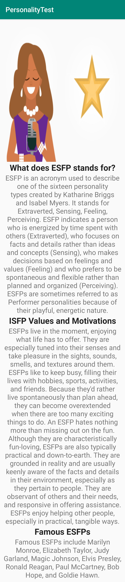
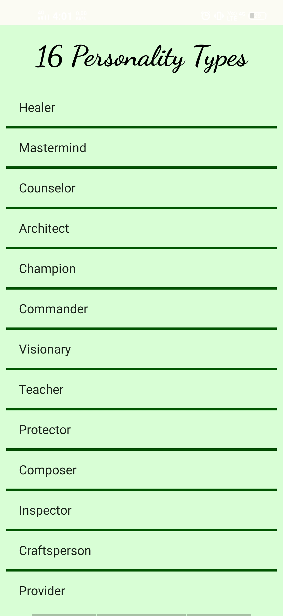
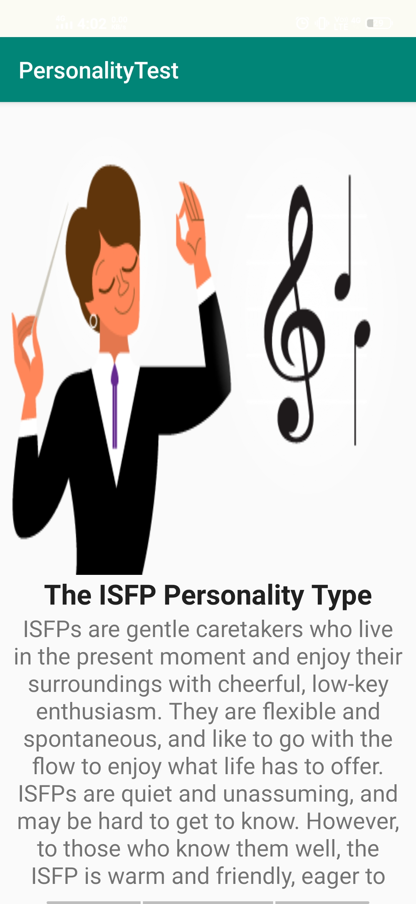
Personality Test –By Three-rrific-Coders

Slide 10
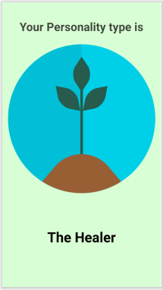


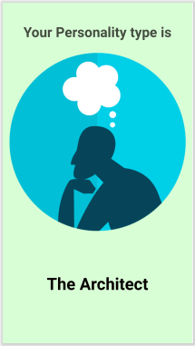
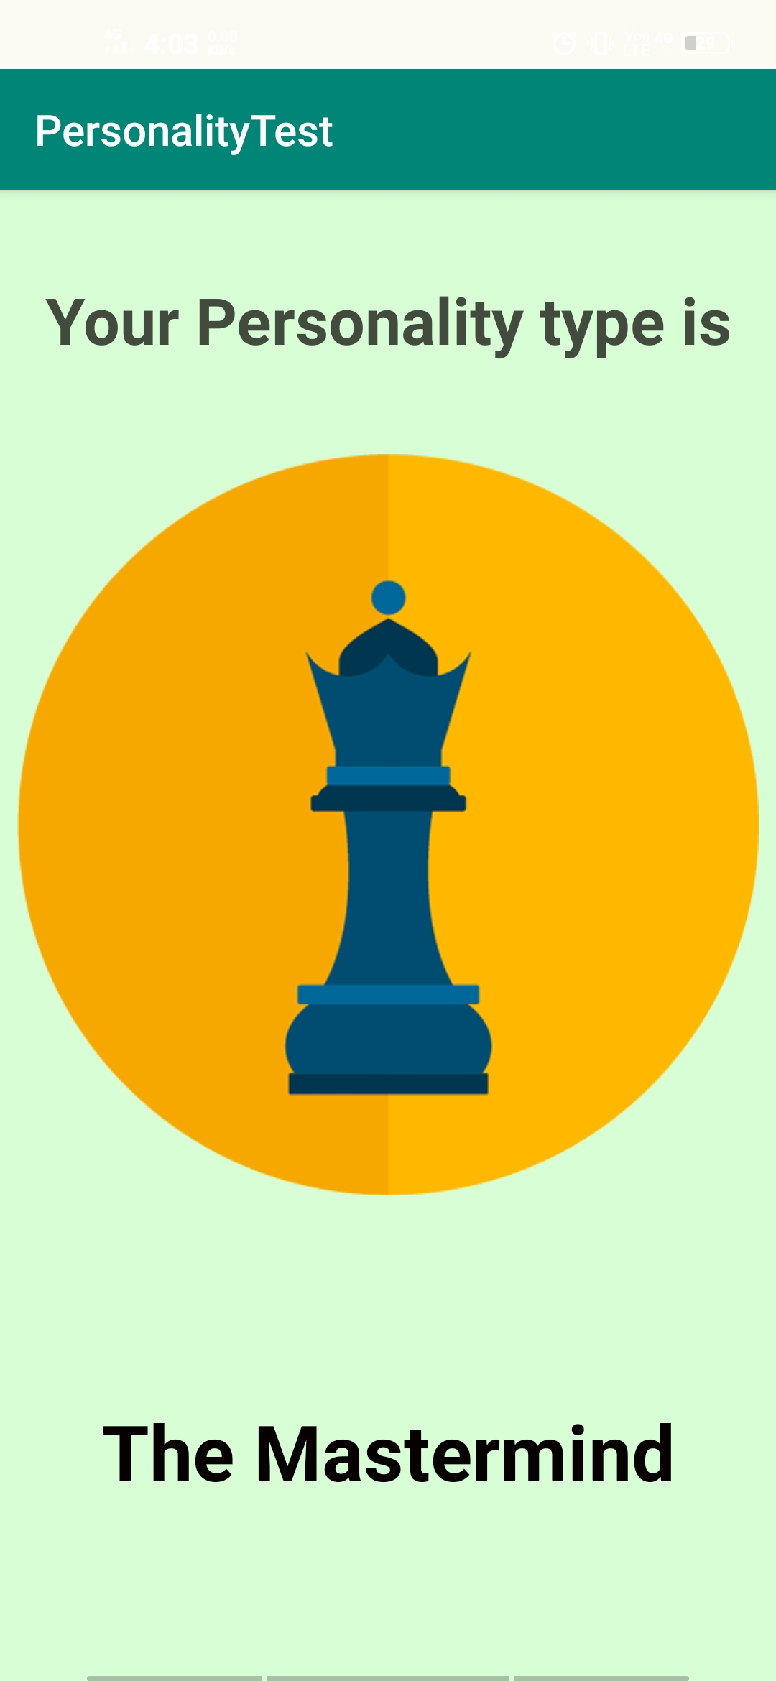


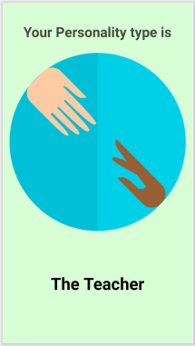
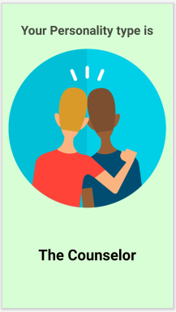


The RESULT
Personality Test –By Three-rrific-Coders

Slide 11

Artificial Intelligence
A branch of computer science dealing with the simulation of intelligent behavior in computers
We have created our own dataset and after filtering the data we trained the model using RNN and then integrated python code with android using Chaquopy (Python SDK for Android)
Personality Test –By Three-rrific-Coders

Slide 12
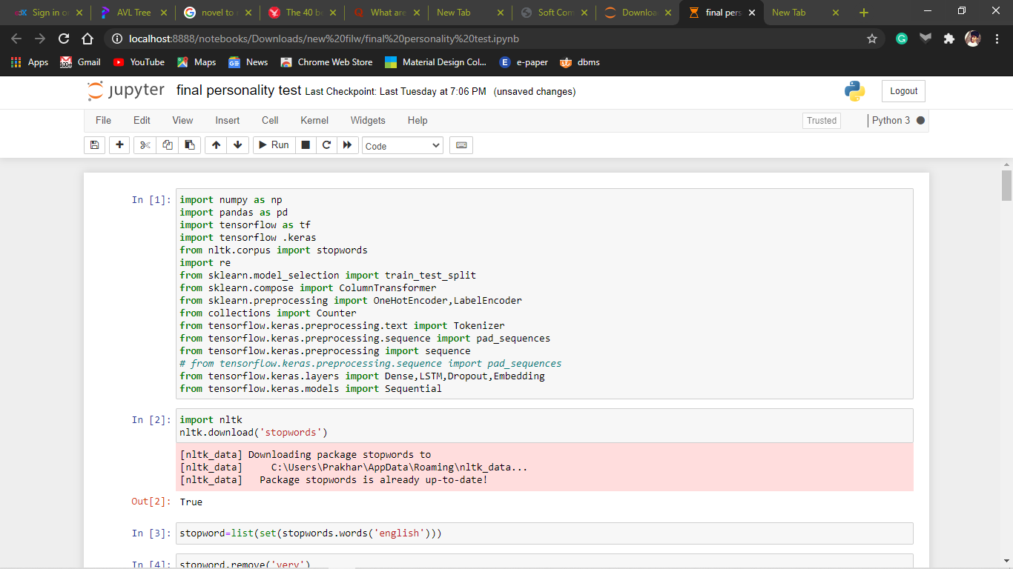
Machine Learning Libraries Used
Personality Test –By Three-rrific-Coders

Slide 13
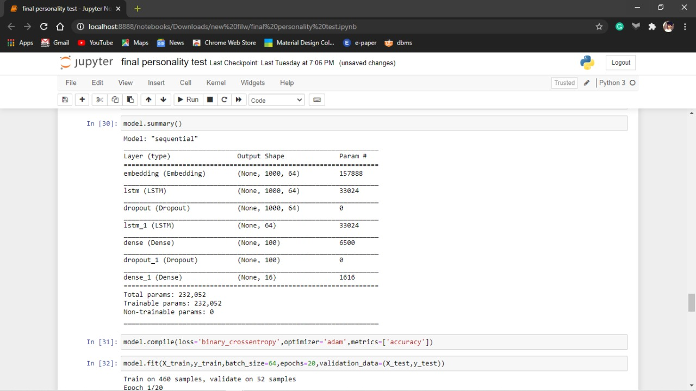
MODEL DESCRIPTION
Personality Test –By Three-rrific-Coders

Slide 14
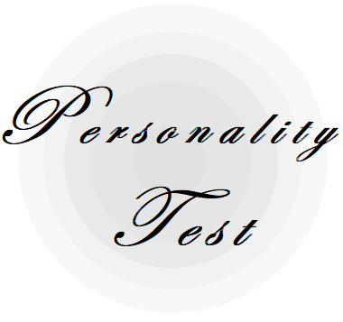

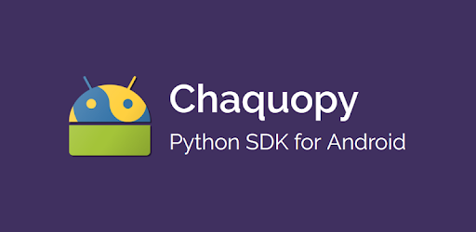

Technology Platform
Android
Software : Android Studio
Developing Language : Java
Interface Language : XML
Android API Level : 21 and Above
Database : SQLite
Chaquopy
enables us to freely intermix Python, Java and Kotlin in any app, using whichever language is best for your needs
Artificial Intelligence
Chaquopy
Software : Anaconda Jupyter Notebook
Developing Language : Python
ML Framework : Tensorflow, Keras
Personality Test –By Three-rrific-Coders

Slide 15





Source credit
truity.com
For written content and icons of 16 personalities
and questions
16personalities.com
We formed our own dataset taking the help of 16personalities.com dataset
Personality Test
Personality Test –By Three-rrific-Coders

Slide 16

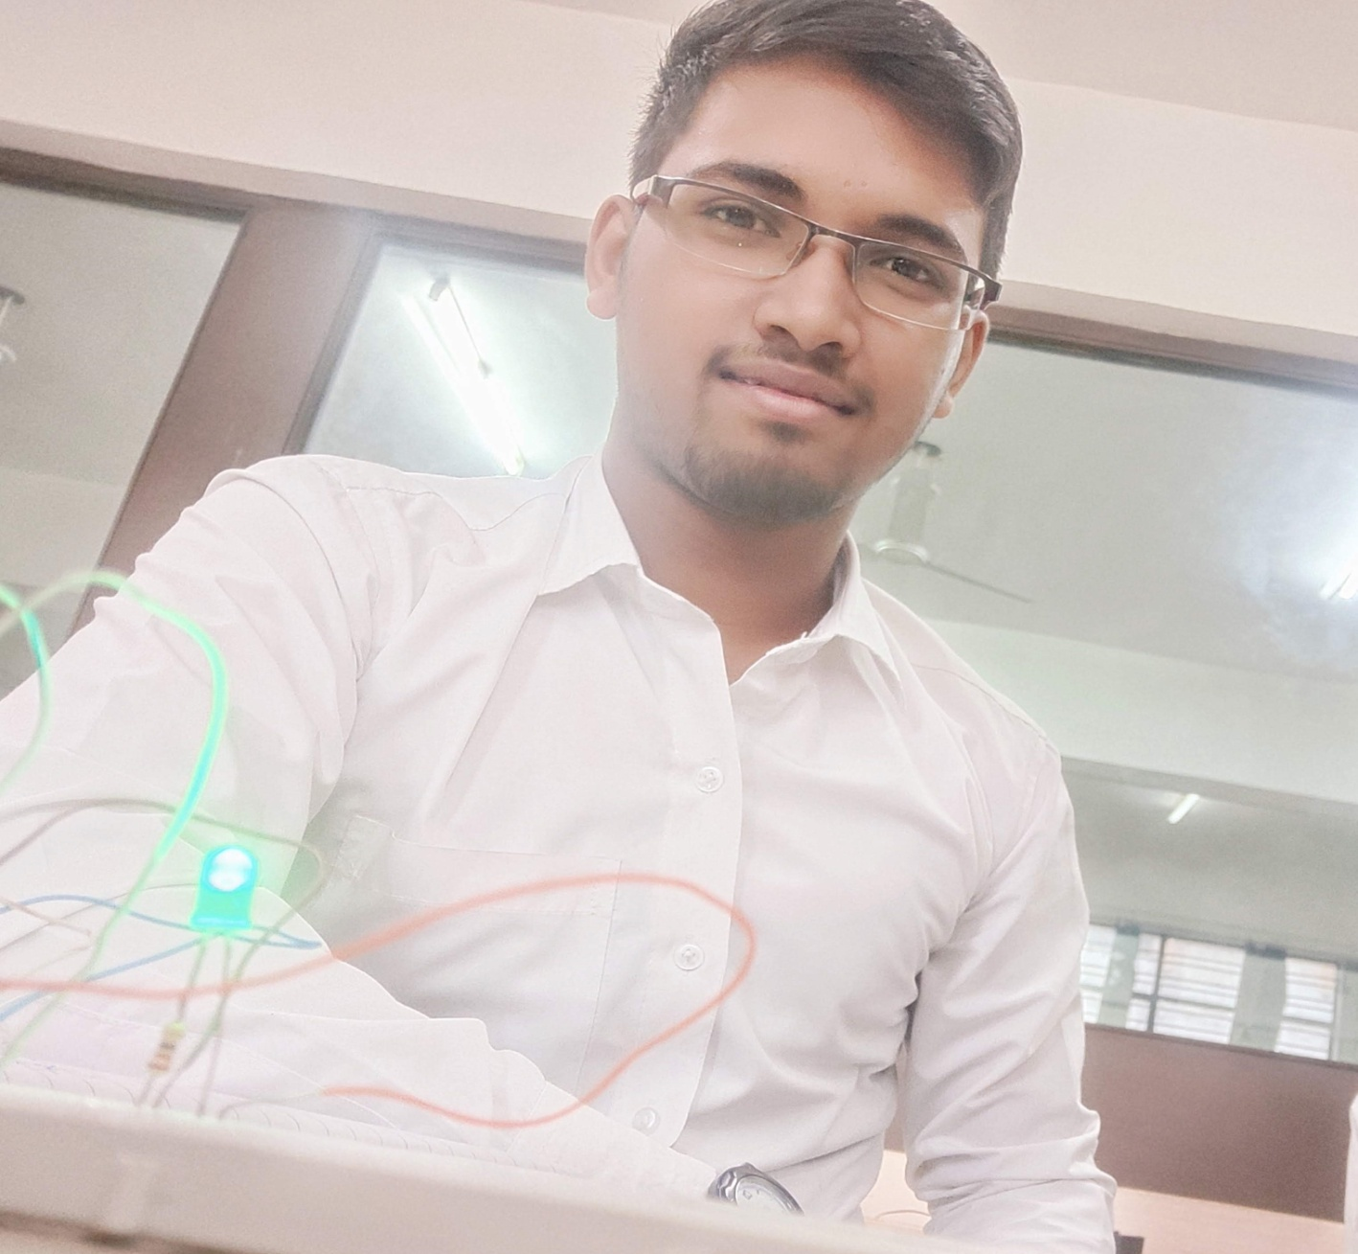

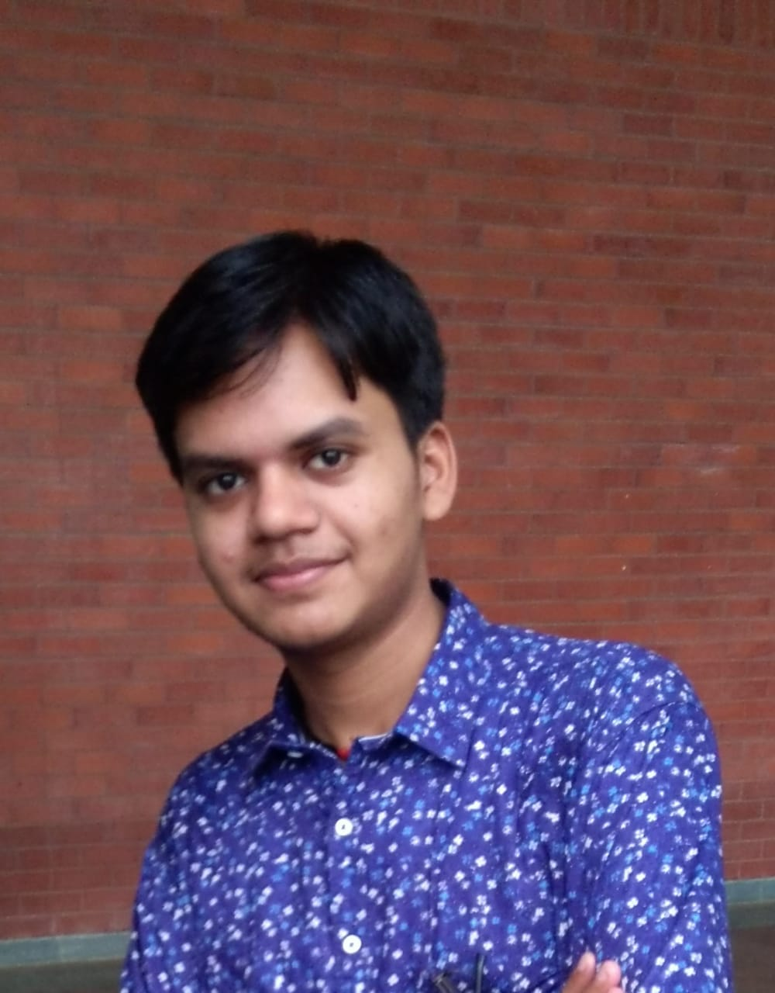
The Three-rrific-Coders
Team members
Priyam Saha
Piyush Agarwal
Android App Dev., Content Design & Team Management
Prakhar Shanker
Machine Learning & Content
Machine Learning & Android
Personality Test –By Three-rrific-Coders

Slide 17
Thank You
Team - Three-rrific-Coders

